Slide 1
Multi-Agent Systems: Patterns & Orchestration
AGENDA:

Slide 3
Example of Travel agent
✈️ Flight Tool
🏨 Hotel Tool
🌤 Weather Tool
📰 News Tool
💰 Cost Calculator
🗺 Maps Tool
📅 Itinerary Generator

Slide 4
. Problem #1 — Agent has too many responsibilities

Slide 5
Problem #2 — The prompt becomes huge

Slide 6
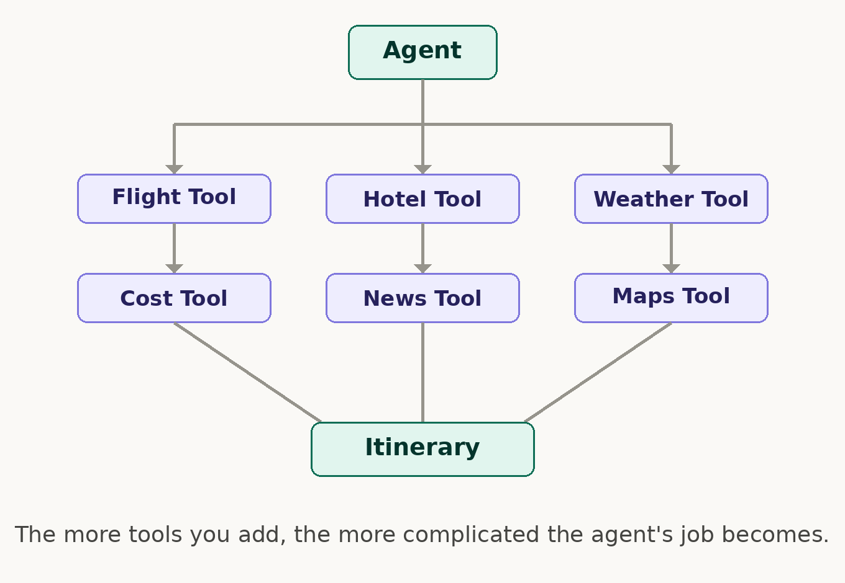
Problem #3 — Too many tools

Slide 7
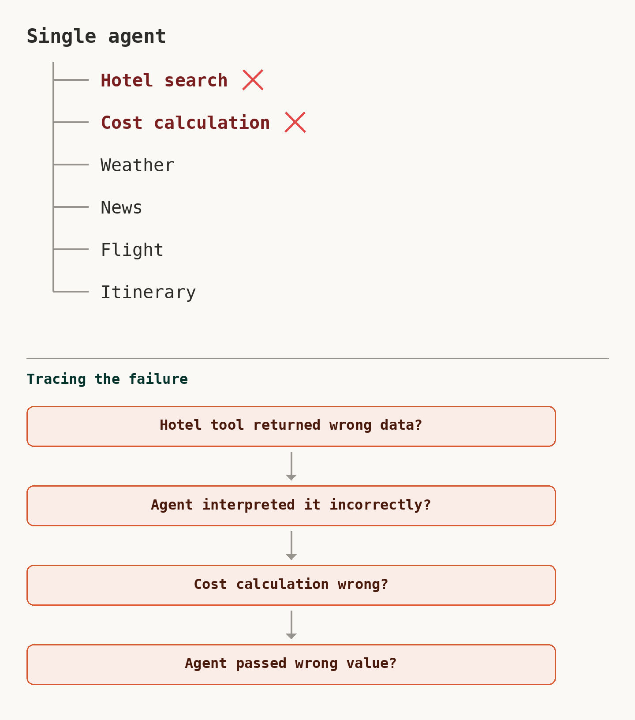
Problem #4 — Difficult to debug

Slide 8
Actual Problem
The problem is not that LangGraph cannot handle a single agent. The problem is that as the application's responsibilities and tools increase, one agent becomes difficult to specialize, debug, control, and maintain.

Slide 9
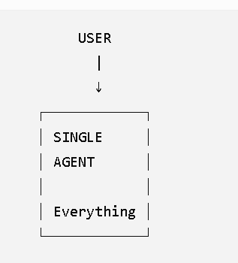
MULTIAGENT
INSTEAD OF :

Slide 10
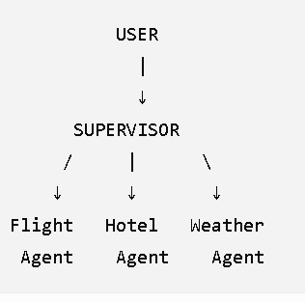
MULTI-AGENT System
We create specialized
agents

Slide 11
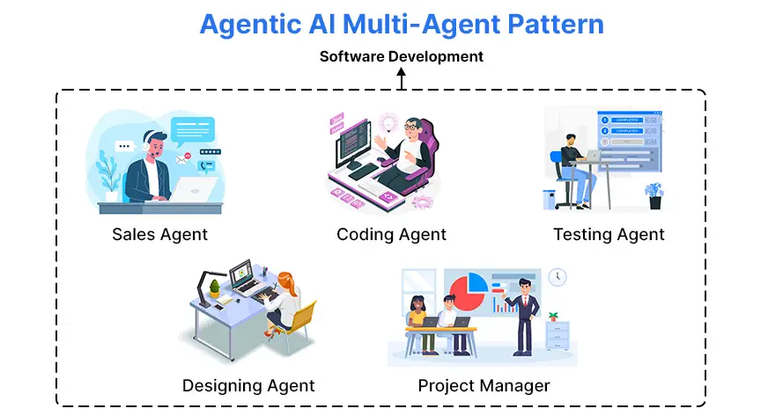
What is a Multi-Agent System?
A multi-agent system is a system where multiple AI agents work together to solve one larger problem, with each agent having a specific responsibility.
Think of it like a team of employees.

Slide 12
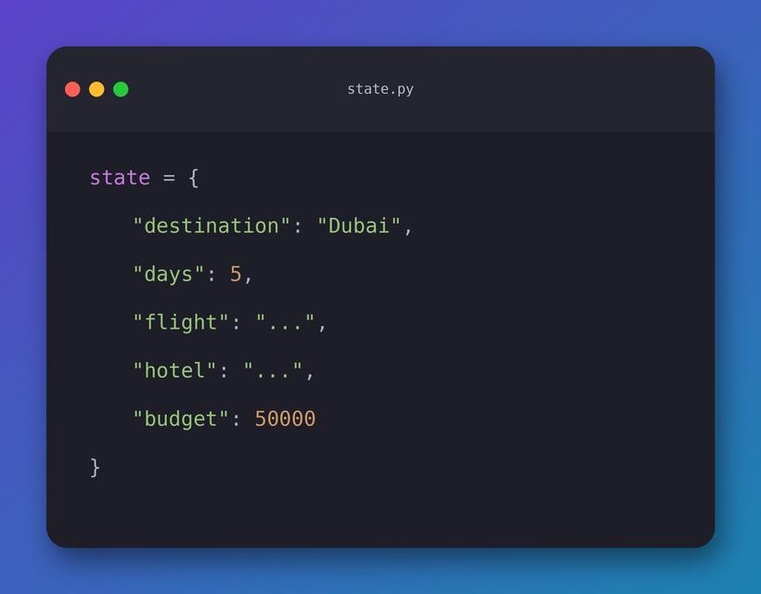
State sharing and communication between agents
Instead of agents directly talking to
each other, they can read and update
a common state.
Each agent gets the state, performs its task,
and returns updates to it.

Slide 13
Cost & Latency in Multi-Agent Systems
More agents usually means more LLM calls → higher cost and potentially higher latency.

Slide 14
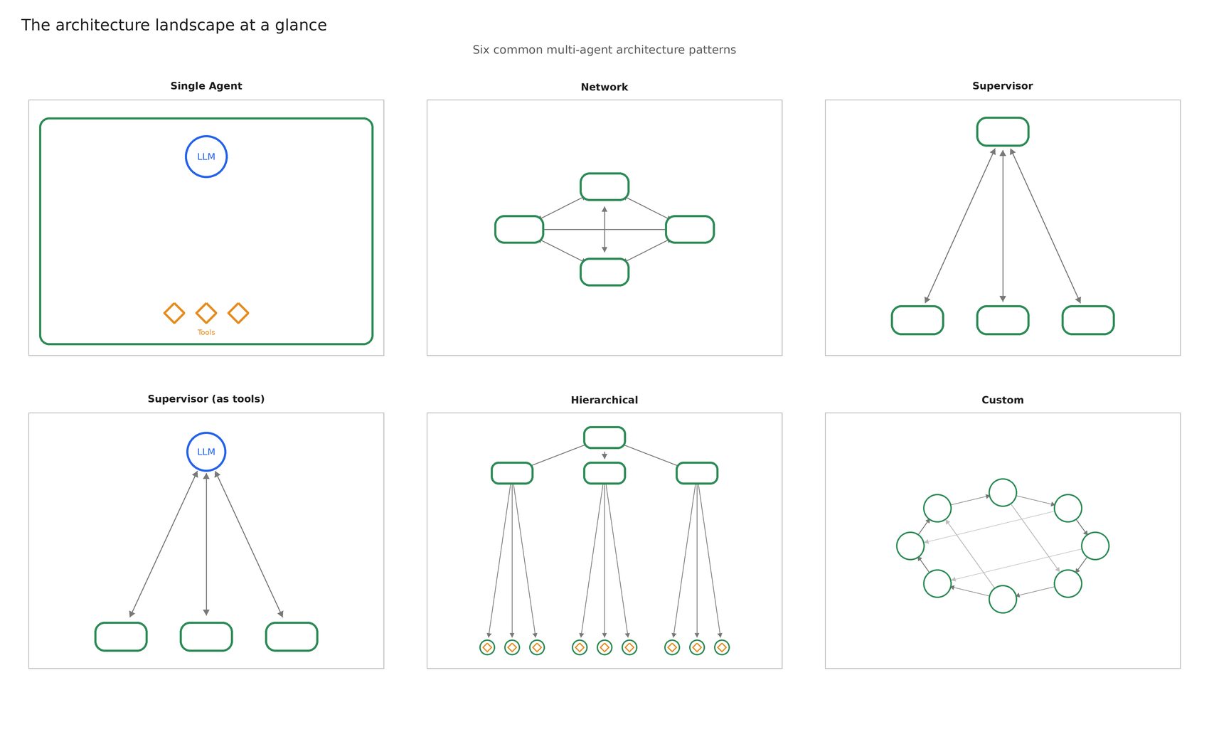

Slide 15
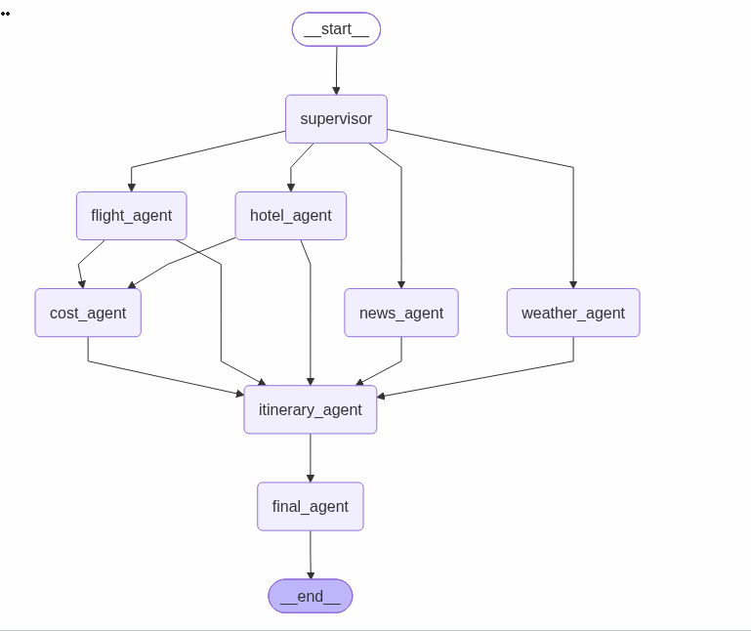
CASE STUDY

Slide 16
